Slide 1
WEKA
The University of Auckland
INFOSYS 722- Big Data and Data Mining

Slide 2
WEKA
Weka is an open source machine learning software. It’s a collection of machine learning algorithms for data mining tasks.
Apart from being Open Source, one of the best things about Weka is that it can be directly applied on to a dataset.
Weka supports: Pre-processing Regression Clustering Association Rules Data Visualization
OS Support:
Windows
Mac
Linux
It has a graphical user interface
Link to Download: https://waikato.github.io/weka-wiki/downloading_weka/

Slide 3

WEKA
That’s where we work on our data

Slide 4
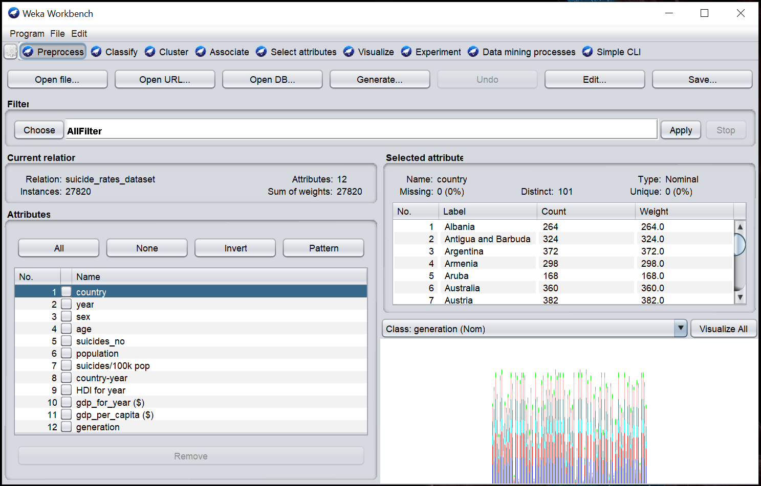

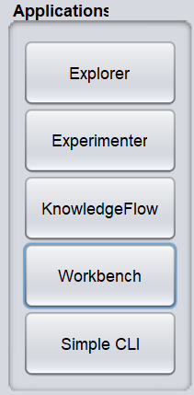

Slide 5
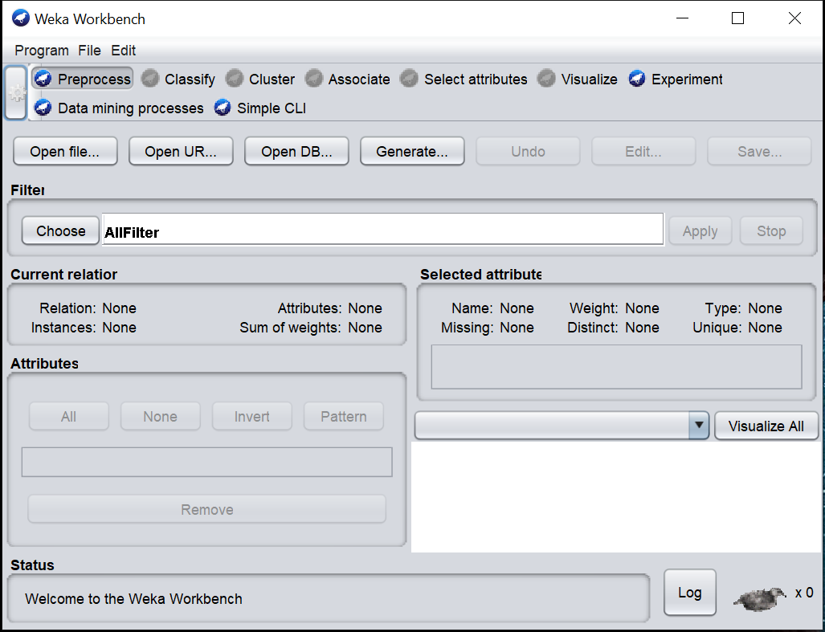
Preprocess
Describing the data.
Data can be imported from a file in various formats:
ARFF, CSV, C4.5, binary
Data can also be read from a URL or from an SQL database

Slide 6
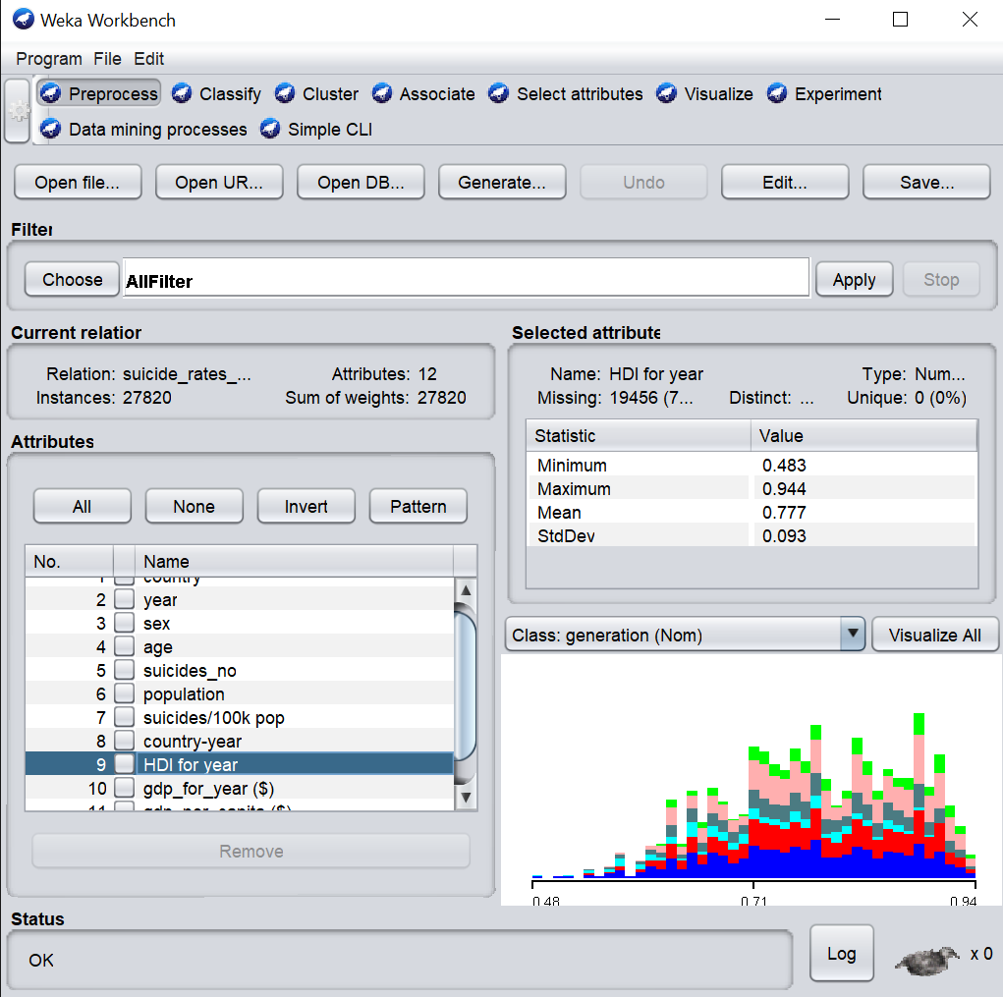
Name. The name of the attribute, the same as that given in the attribute list.
Type. The type of attribute, most commonly Nominal or Numeric.
Missing. The number (and percentage) of instances in the data for which this attribute is missing (unspecified).
Distinct. The number of different values that the data contains for this attribute.
Unique. The number (and percentage) of instances in the data having a value for this attribute that no other instances have.
Structure of data

Slide 7
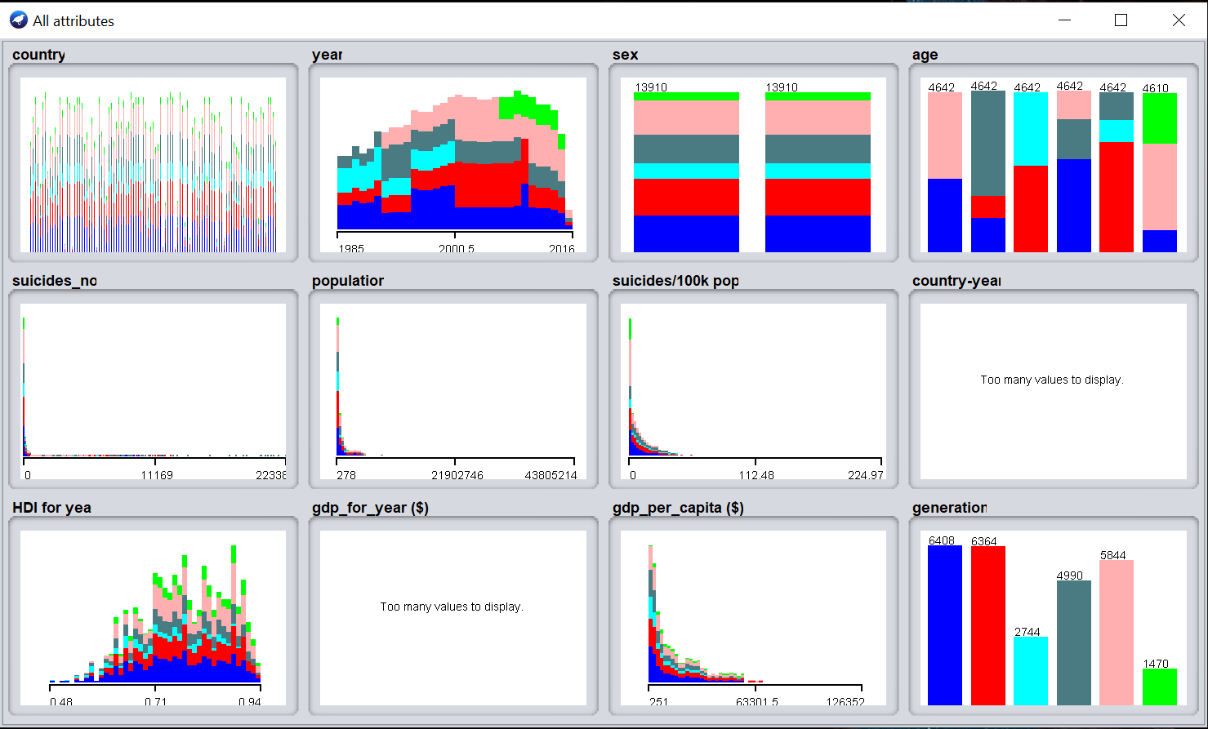
Colored histogram, color-coded according to the attribute chosen as the Class using the box above the histogram.
Note that only nominal Class attribute swill result in a color-coding.

Slide 8
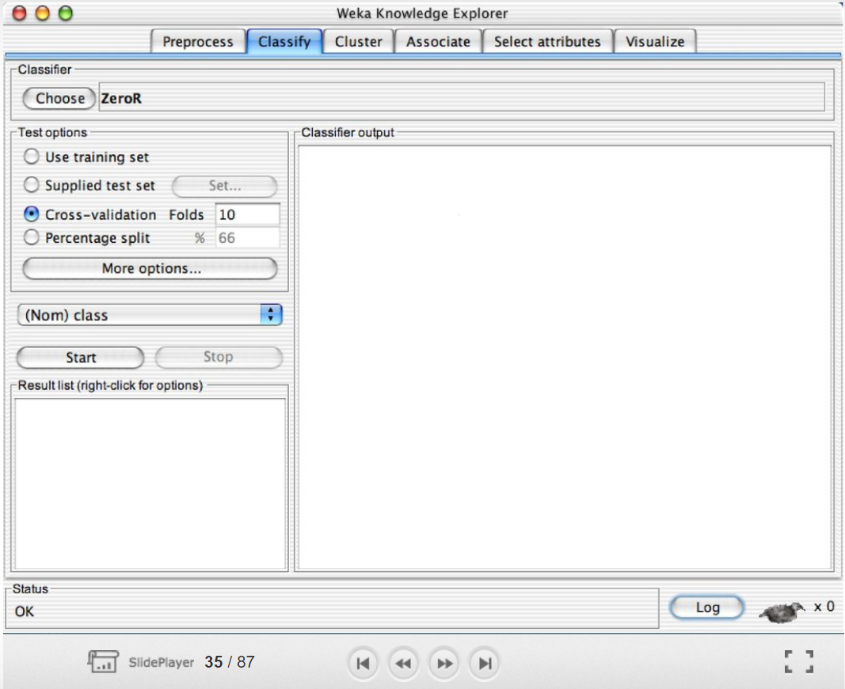
Classify
Classifiers in WEKA are models for predicting nominal or numeric quantities.
Implemented learning schemes include: Decision trees and lists, instance-based classifiers, support vector machines, multi-layer perceptrons, logistic regression, Bayes’ nets etc.

Slide 9
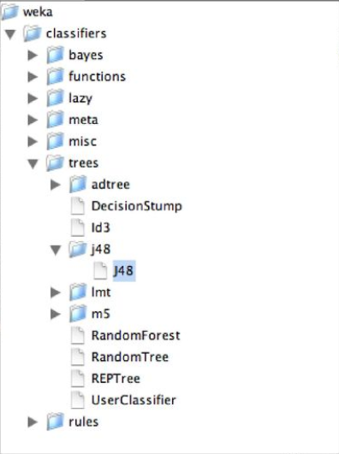
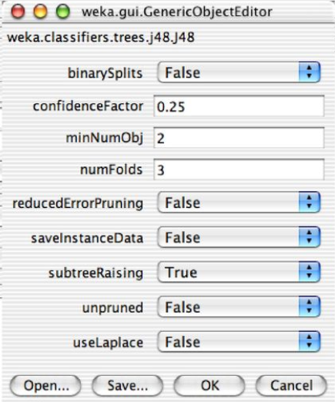
Classify
‘binarySplits’: Whether to use binary splits on nominal attributes when building the trees.
‘saveInstanceData’: Whether to save the training data for visualization.

Slide 10
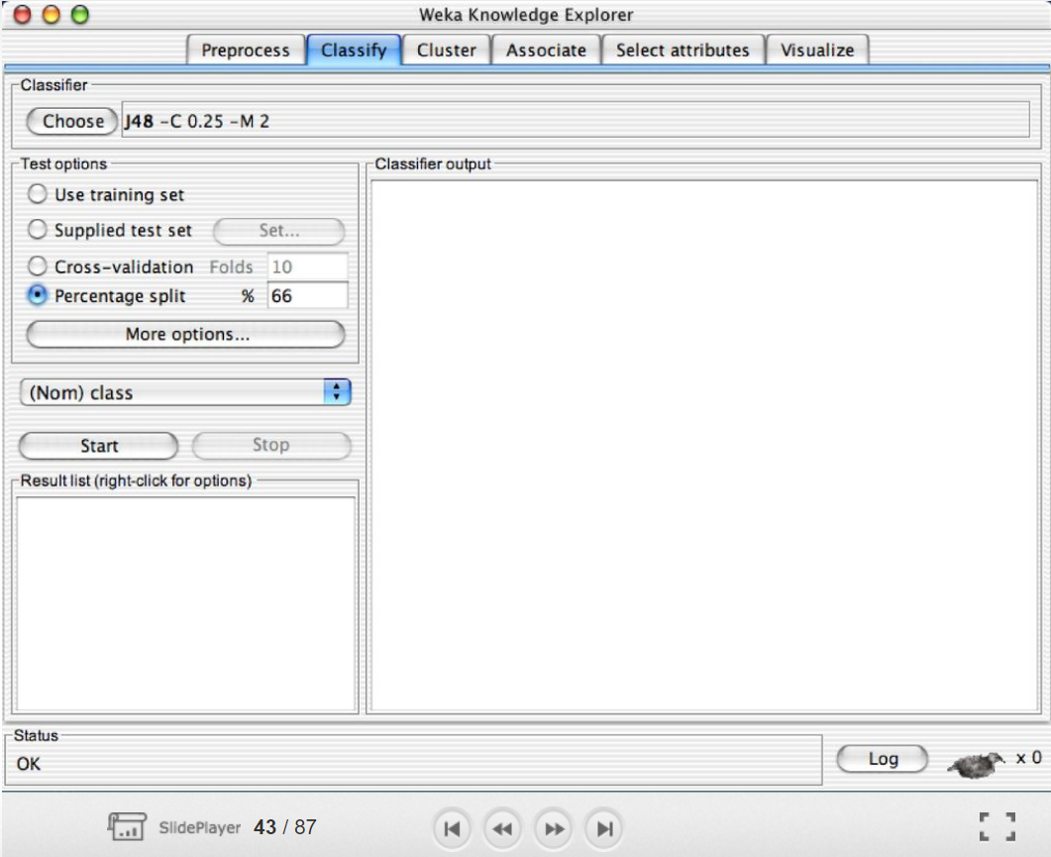
Classify
Use training set. The classifier is evaluated on how well it predicts the class of the instances it was trained on.
Supplied test set. The classifier is evaluated on how well it predicts the class of a set of instances loaded from a file. Clicking the Set... Button brings up a dialog allowing you to choose the file to test on.
Cross-validation. The classifier is evaluated by cross-validation, using the number of folds that are entered in the Folds text field.
Percentage split. The classifier is evaluated on how well it predicts a certain percentage of the data which is held out for testing.

Slide 11
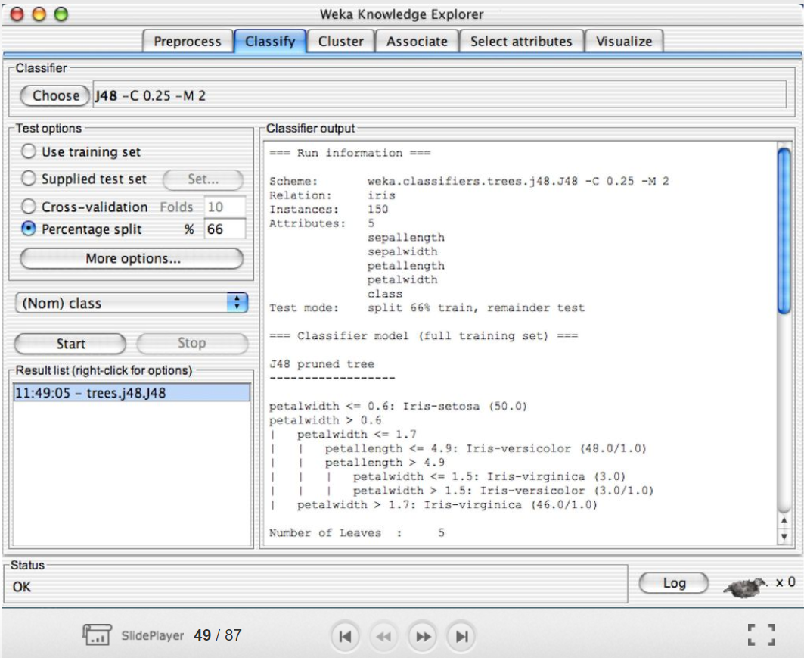
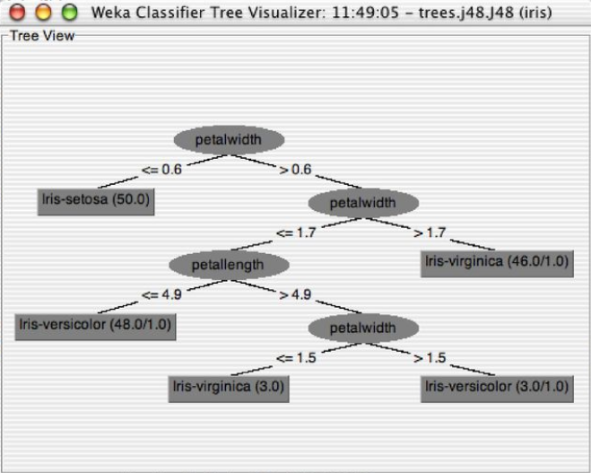
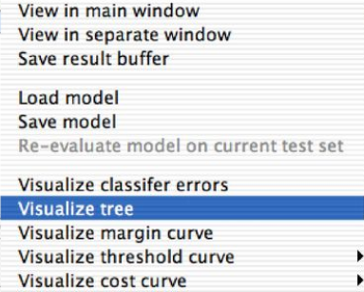
Classify

Slide 12
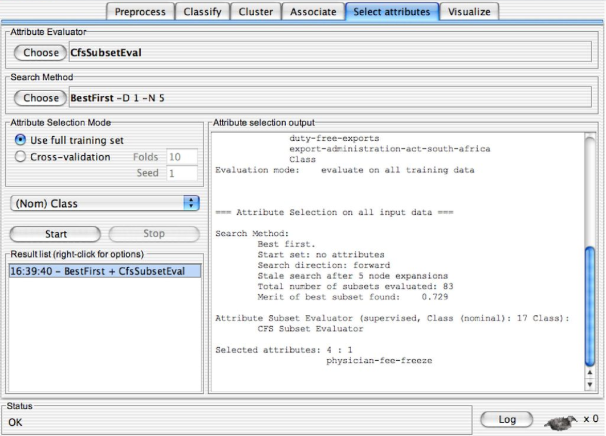
Select Attributes
Select Attributes can be used to investigate which attributes are the most predictive ones.
Attribute selection methods contain two parts:
A search method: best-first, forward selection, random, exhaustive, genetic algorithm, ranking.
An evaluation method: correlation-based, wrapper, information gain, chi-squared.
WEKA allows any arbitrary combinations of these two

Slide 13
Select Attributes
Attribute Selection Mode:
Use full training set. The worth of the attribute subset is determined using the full set of training data.
Cross-validation. The worth of the attribute subset is determined by a process of cross-validation. The Fold and Seed fields set the number of folds to use and the random seed used when shuffling the data.

Slide 14
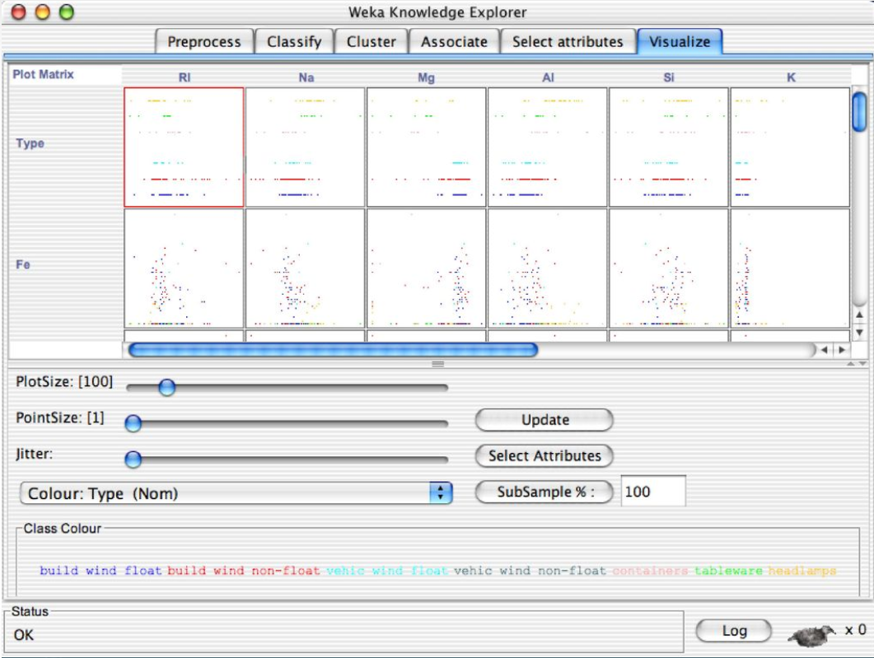
Visualize
Visualization is a very useful in practice and one of the most important activities in KDD process of data mining (if not The Most)
WEKA can visualize single attributes (1-d) and pairs of attributes (2-d)
Color-coded class values
‘Jitter’ option to deal with nominal attributes (and to detect ‘hidden’ data points)

Slide 15
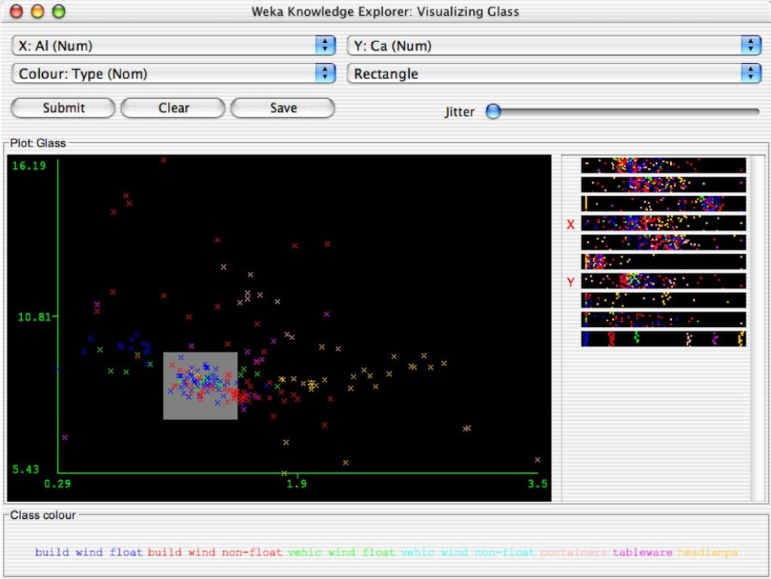
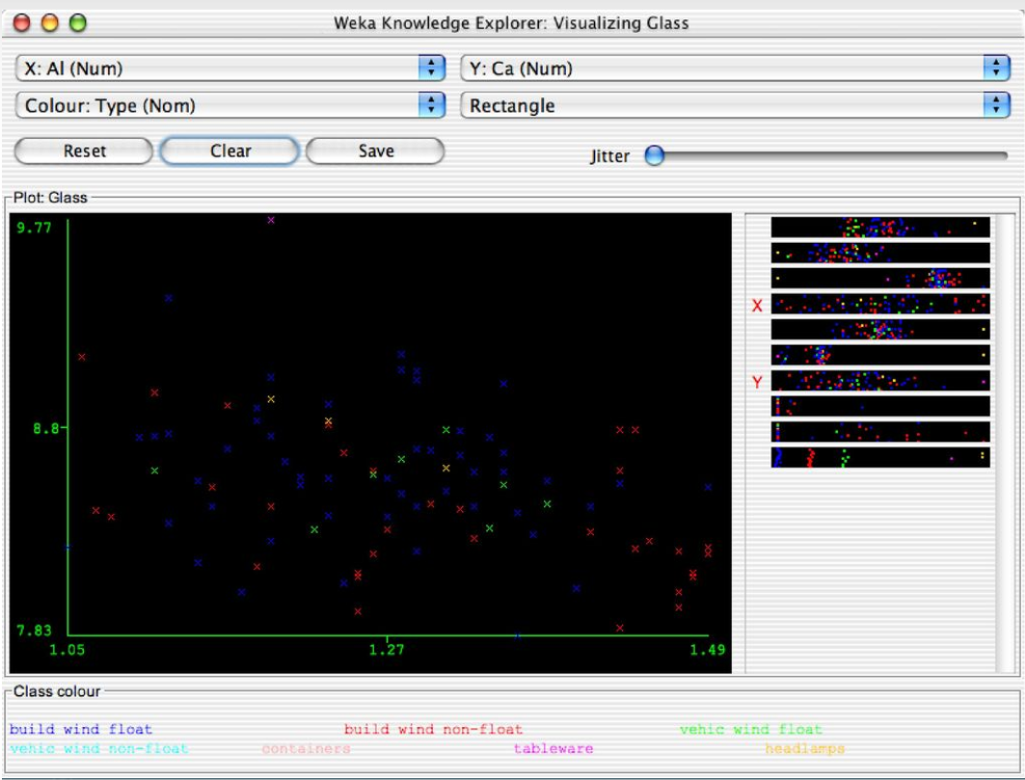
Visualize- Zoom In
2
1
3

Slide 16






722 Team
Academic Director and Lecturer
Dr Ami Peiris
Email: a.peiris@auckland.ac.nz
Coordinators and Tutors
Shahzad Khan (Course Coordinator) Email: shahzad.khan@auckland.ac.nz
Shahab Bayati Email: s.bayati@auckland.ac.nz
Ankit Gandhi Email: ankit.gandhi@auckland.ac.nz
Di Zhao Email: dzha866@aucklanduni.ac.nz
Shohil Kishore Email: s.kishore@auckland.ac.nz

